Slide 1
Azure Foundations

Slide 2
Topics
Enterprise Components Overview
Enterprise Roles
Primitives
Azure Authorization
Azure RBAC roles
Classic subscription admin roles
Azure Policy

Slide 3
Enterprise Components Overview
Enterprise Agreement
Contractual agreement with Microsoft that allows for purchase of software licenses, cloud services, and support
Enrollment
Describes the shape and use of Azure services your company will consume
Department
Optional entity that allows you to segment costs into logical groupings and set a budget or quota at the department level (note budget not enforceable)
Account
Globally unique entity that gets you access to Azure services and subscriptions
Subscription
Logical container for Azure resources
Notes:
Resources
https://docs.microsoft.com/en-us/azure/cost-management-billing/manage/ea-portal-get-started

Slide 4
Enterprise Roles
Enterprise Administrator
Manage accounts and account owners
Manage other Enterprise Administrators and Department Administrators
View usage across all accounts and unbilled charges across all accounts
Can be granted read-only access
Department Administrator (Optional)
Create and manage departments
Create new account owners
View usage details for departments they manage and view costs if they have necessary permissions
Can be granted read-only access
Account Owner
Create and manage subscriptions
Manage Service Administrators
View usage for subscriptions
Manage Notification contacts
Notes:
When transferring account, target account me be valid Azure commerce account
Transferring subscriptions between tenants results in losing all Azure Policy assignments, RBAC assignments/definitions
Resources
https://docs.microsoft.com/en-us/azure/cost-management-billing/manage/understand-ea-roles

Slide 5
Enterprise Roles (Continued)
EA Purchaser
Has permissions to manage services in Azure Portal and assign users to co-administrator role
Notification Contact
Receive usage information related to enrollment
Service Administrator
Purchase Azure services including reservations
View usage across all accounts
View and manage all reservations orders

Slide 6
Enterprise Components/Roles – Design Recommendations
Use Azure AD authentication only (Work and School accounts) and avoid using Microsoft Live accounts
For privileged roles use shared accounts where credentials are secured in password management system and email address for the account is configured to send its mail to a distribution list accessible by multiple individuals (EA Admins, Account Owners)
Consider creating separate Azure Account for non-production and production to limit blast radius since Account Owners are be made subscription owner for any subscription provisioned under the account
Notes:
* https://docs.microsoft.com/en-us/azure/cloud-adoption-framework/ready/enterprise-scale/enterprise-enrollment-and-azure-ad-tenants

Slide 7
Primitives - Azure AD Tenant
Identity plane for Microsoft Cloud Services
Identity repository for human and non-human identities
Multifactor Authentication
Conditional Access
Critical blast radius

Slide 8
Primitives - Azure AD Tenant Design Recommendations
Limit number of Azure AD Tenants to reduce operational overhead
Use a single Azure AD Tenant for production, non-production, and development Azure workloads
Ensure privileged roles such as Global Admins and User Administrators are granted on a per use and time bound basis through a privileged access management system such as Azure AD Privileged Identity Management, CyberArk, or Thycotic
Create breakglass accounts for Azure AD to recover control in case of a security incident or outage of on-premises identity infrastructure

Slide 9
Primitives - Azure AD Tenant Design Recommendations (continued)
Enforce MFA for all users and use conditional access to further evaluate context of user’s authentication
For Azure workloads use Managed Identities instead of Service Principals whenever possible
Rotate credentials for Service Principals on a regular basis

Slide 10
Primitives - Management Groups
Logical containers for subscriptions
Enforce authorization (Azure RBAC)
Enforce compliance (Azure Policy)
Notes:
Resources
https://docs.microsoft.com/en-us/azure/governance/management-groups/overview

Slide 11
Primitives – Management Group Design Recommendations
Keep the management group hierarchy flat and limited to four levels
Tightly control access to management groups limiting it to a service principal if possible
Limit the Azure Policy and RBAC assignments assigned to the tenant root management group to reduce the complexity of troubleshooting issues with policy or authorization
Create a default management group for new subscriptions to ensure a minimum level of security can be applied to the subscriptions
Notes:
Note that leveraging service principals for management of management groups requires maturity with the platform that will not be there out of the gates
Resources
https://docs.microsoft.com/en-us/azure/governance/management-groups/how-to/protect-resource-hierarchy
https://docs.microsoft.com/en-us/azure/cloud-adoption-framework/ready/enterprise-scale/management-group-and-subscription-organization

Slide 12
Primitives - Subscriptions
Limits boundary
Authorization boundary (blast radius)
Compliance boundary (Azure Policy)
Blast radius
Cost boundary
Notes:
Resources
https://docs.microsoft.com/en-us/azure/governance/management-groups/overview

Slide 13
Primitives – Subscriptions Design Recommendations
Separate subscriptions dedicated for core infrastructure services and separate from subscriptions used for workloads to limit the blast radius
Use subscriptions as a boundary for workloads that require a specific set of controls such as PCI
Remember that resources within a subscription can only use a virtual network within the same subscription
Establish a formalized process for the creation of new subscriptions to avoid subscription bloat
Notes:
Resources
https://docs.microsoft.com/en-us/azure/cloud-adoption-framework/ready/enterprise-scale/management-group-and-subscription-organization

Slide 14
Primitives – Resource Groups
Logical container for Azure resources
Authorization boundary
Compliance boundary (Azure Policy)
Notes:
Resources
https://docs.microsoft.com/en-us/azure/governance/management-groups/overview

Slide 15
Primitives – Resource Group Design Recommendations
Group workload resources which will share the same lifecycle and control
Use as an authorization boundary to minimize the blast radius to a specific application
Avoid assigning policies at the resource group layer due to the operational overhead

Slide 16
Azure Authorization
Azure Active Directory admin roles
Azure RBAC roles
Classic subscription admin roles
Azure account Admin

Slide 17
Azure Classic Subscription Admin Roles
Account Administrator
Billing owner of the subscription
1 per Azure account
Create, cancel, change subscription
Service Administrator
Essentially the administrator of a particular subscription
By default is the Account Administrator
1 per subscription
Equivalent of Owner role at the subscription scope
Cancel the subscription or assign co-administrators
Co-Administrator
Same access privileges as Service Administrator but can’t change association of Azure subscription to another Azure AD directory
Equivalent of Owner role at the subscription scope
200 per subscription
Notes:
Resources
https://docs.microsoft.com/en-us/azure/role-based-access-control/rbac-and-directory-admin-roles#classic-subscription-administrator-roles

Slide 18
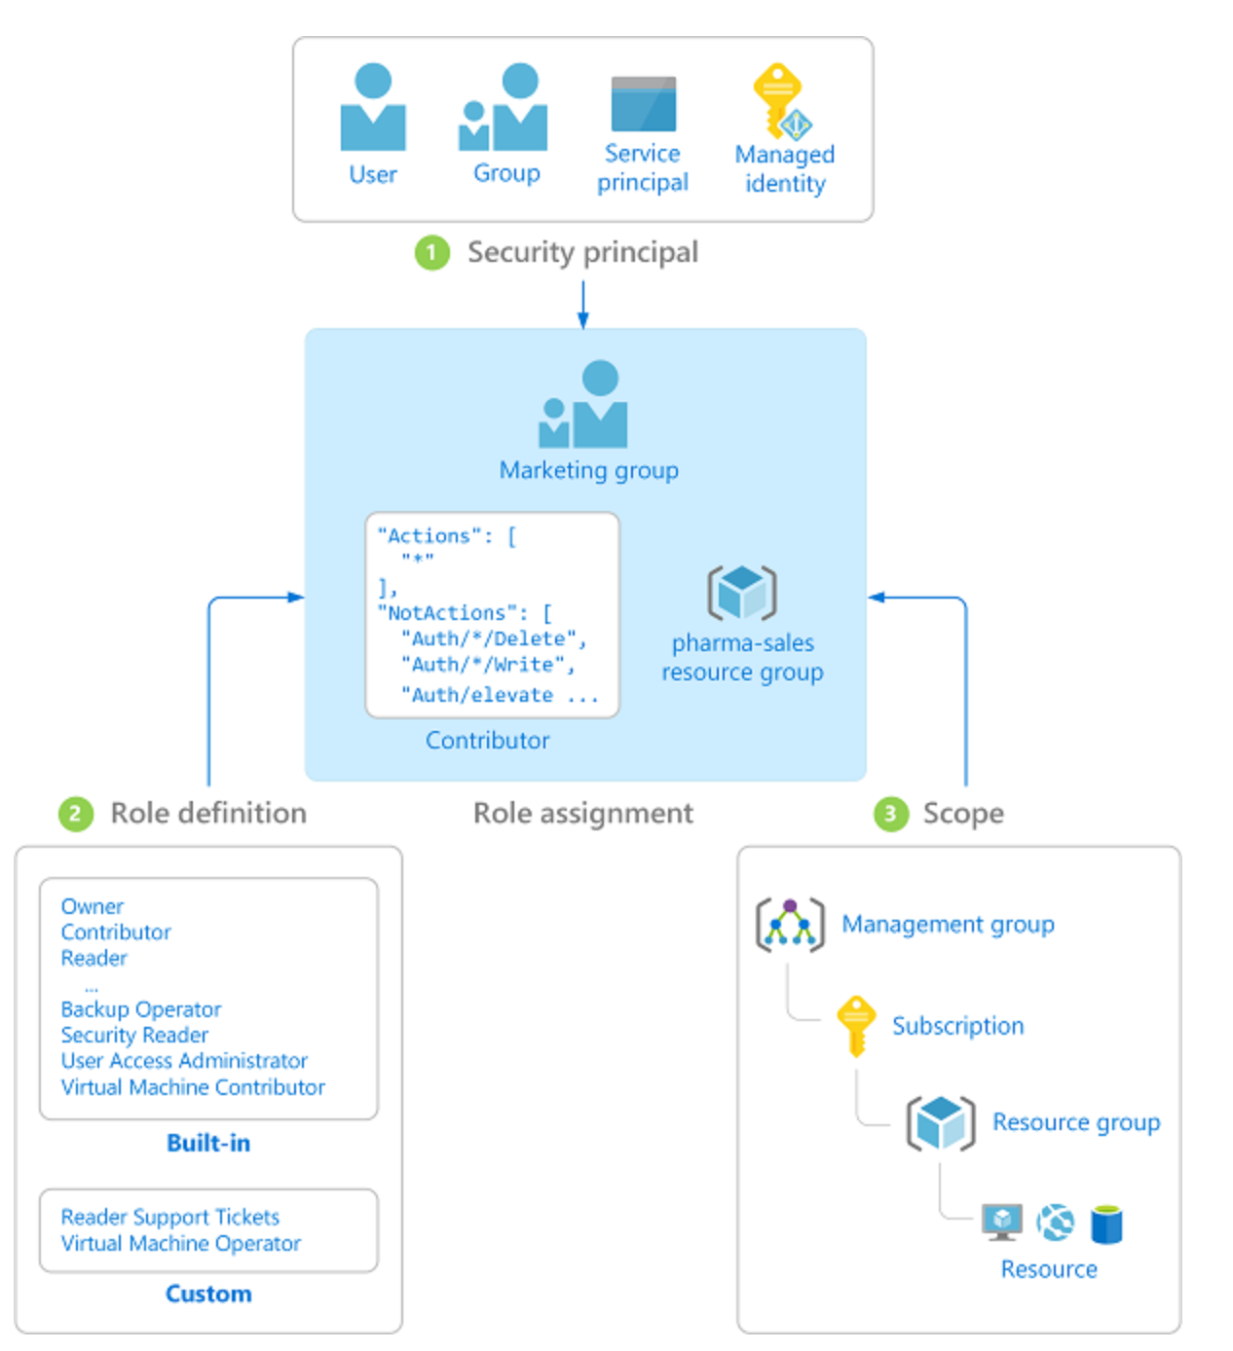
Azure RBAC (Role-Based Access Control)
Security Principal
User, group, service principal, managed identity
Role Definition
Collection of permissions (Actions, NotActions, DataActions, NotDataActions, AssignableScopes)
Scope
Set of resources the access applies to
Management Groups, Subscriptions, Resource Group, Resources
Role Assignment
Process of attaching role definition to a security principal
Notes:
Resources
https://docs.microsoft.com/en-us/azure/role-based-access-control/overview

Slide 19
Azure RBAC - Design Recommendations
Establish a RACI which outlines the specific tasks each function in your organization will perform in Azure
Follow best practices for least privilege and separation of duties for both humans and non-humans
Leverage Just-In-Time concepts for granting privileged roles which can include Azure AD Privileged Identity Management or a third-party PAM/PSM
Start with built-in role definitions and customize as needed

Slide 20
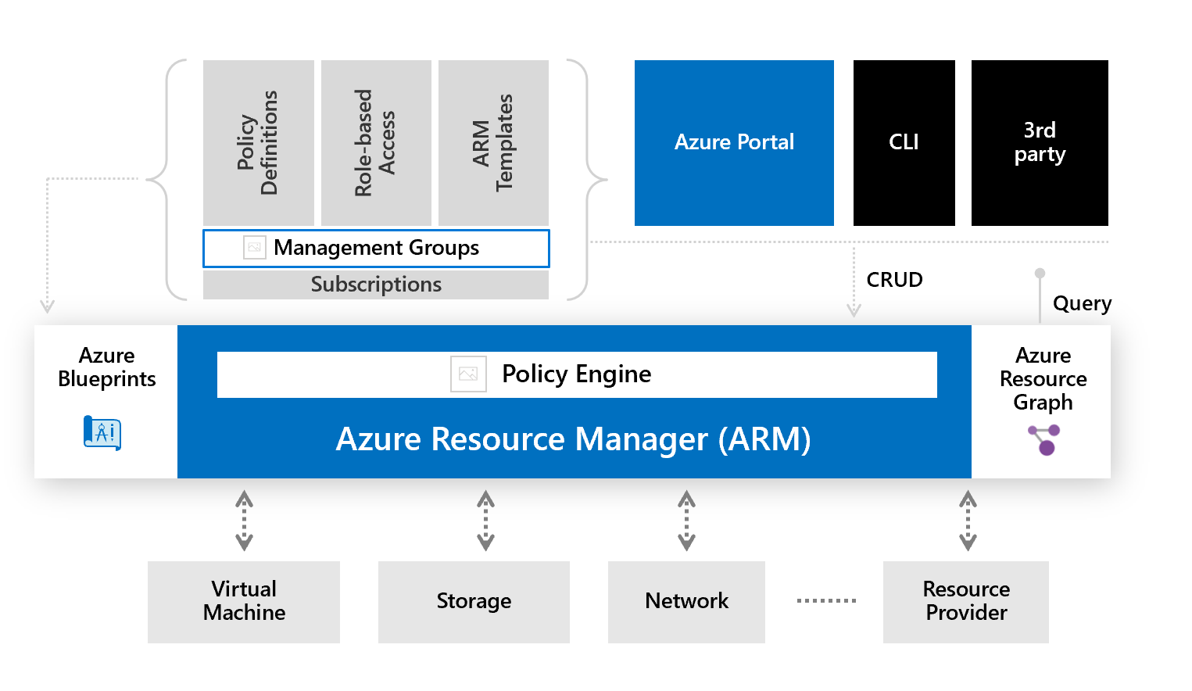
Azure Policy
Enforce organizational governance and compliance
Evaluates resource properties
Enforced as request flows through ARM API
Policies consist of a definition and an assignment
Policies can be consolidated into an initiative
Assign policy at the management group, subscription, resource group, and resource level
Notes:
Policy and initiative definitions are stored at management group or subscription level
Resources
https://docs.microsoft.com/en-us/azure/governance/policy/overview
https://journeyofthegeek.com/2019/09/15/tips-and-tricks-for-writing-azure-policy/

Slide 21
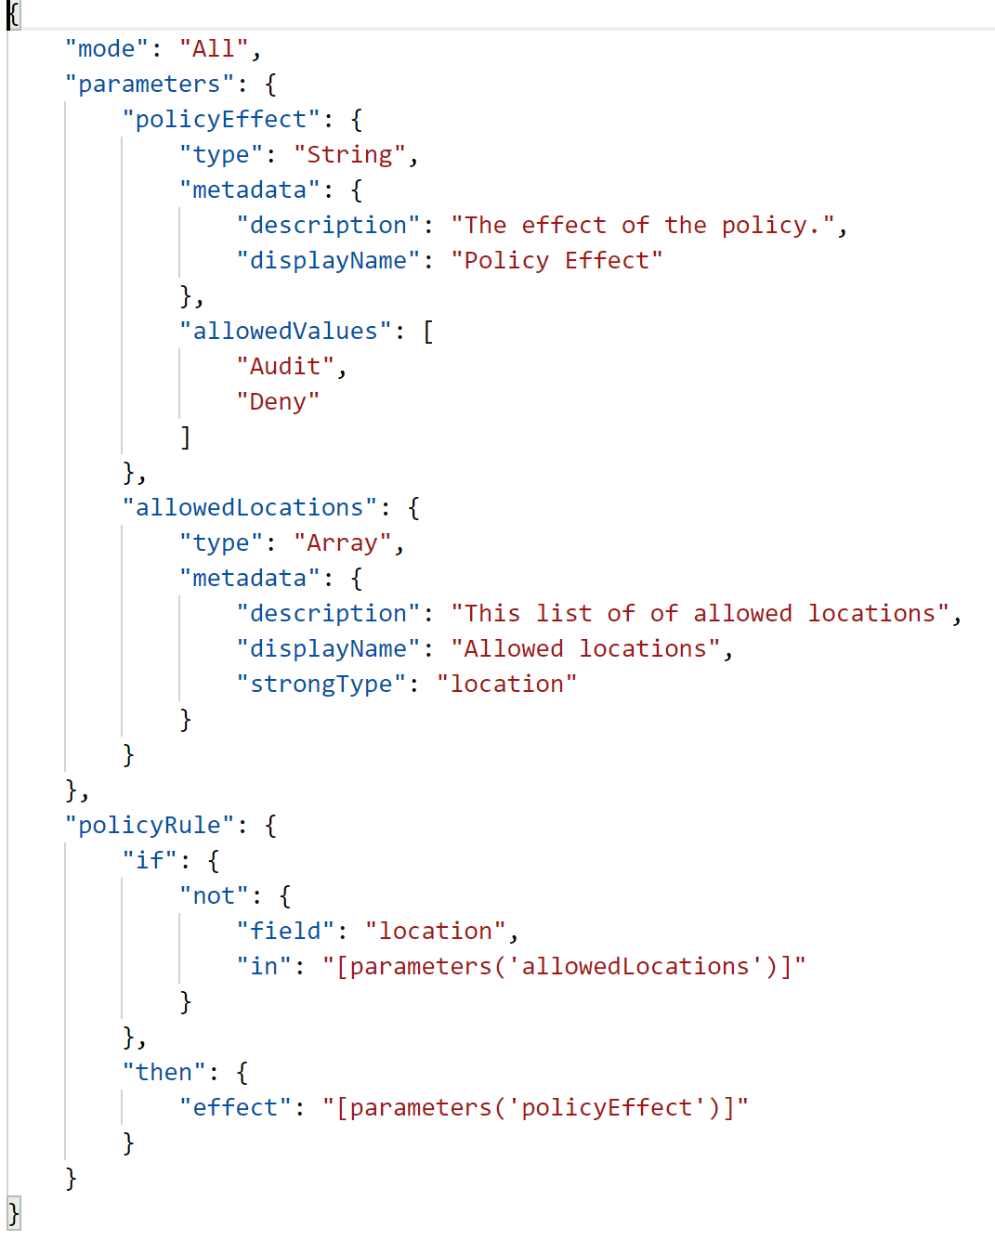
Azure Policy
JSON structure
Audit, Deny, and Deploy If Not Exists
If-Then Logic
Incorporate parameters, built-in functions
Many built in policies for common compliance frameworks such as PCI, ISO 27001, CIS
Notes:
Resources
https://github.com/Azure/azure-policy
https://github.com/Azure/Community-Policy

Slide 22
Azure Policy - Design Recommendations
Know the laws, regulations, and standards your organization is subject to and understand which controls you inherit from Microsoft and which you are responsible for
Try to stick with assigning policies at the Management Group and Subscription level to avoid operational overhead
Start with the Azure Security Benchmarks policy initiative as a baseline and leverage other built-in policy initiatives Microsoft provides such as CIS
Ensure you understand and agree with the control mapping Microsoft has created for the built-in policy initiatives
Before you create a custom policy validate it doesn’t already exist as a built-in policy or community policy

